Slide 1
Artificial Intelligence in Video Game Design
By Chance L. Womack

Slide 2
Topics of Discussion
01.
Artificial Intelligence in Asset Generation
02.
Artificial Intelligence in Game Development
03.
Artificial Intelligence in Player Experience

Slide 3
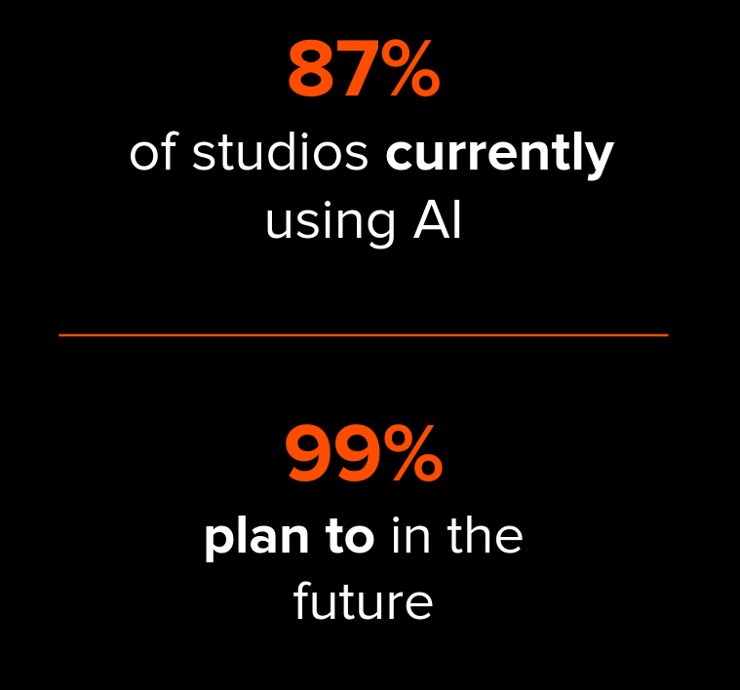
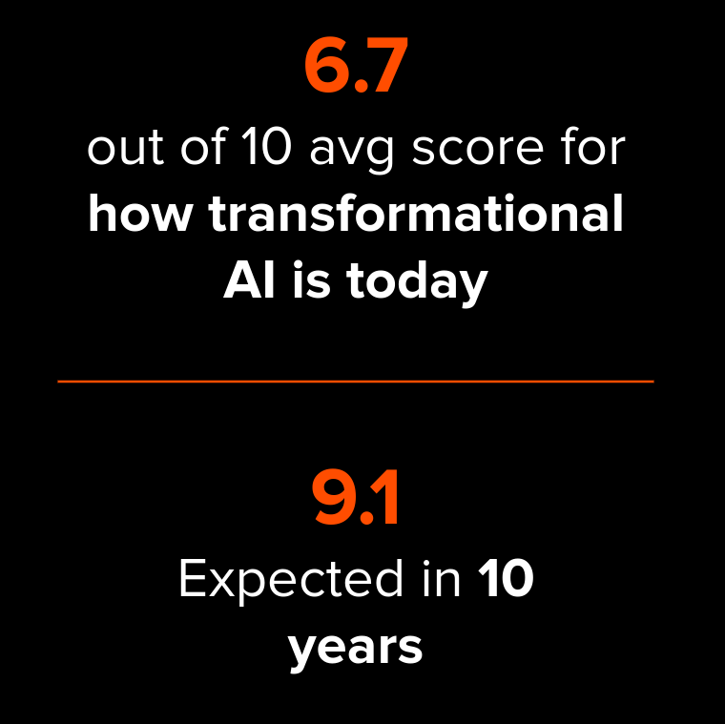
A16Z, 2023 AI x Game Development Survey

Slide 4
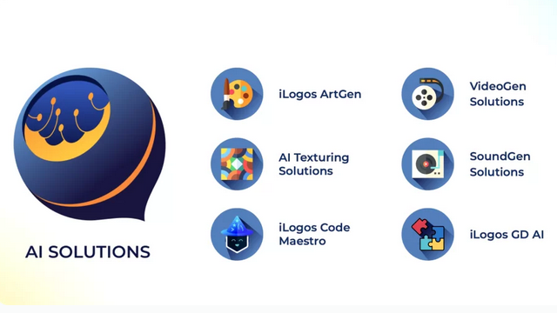
iLogos, Marketing AI Solutions

Slide 5

“A Recent Entrance to Paradise”
Thaler vs Perlmutter

Slide 6
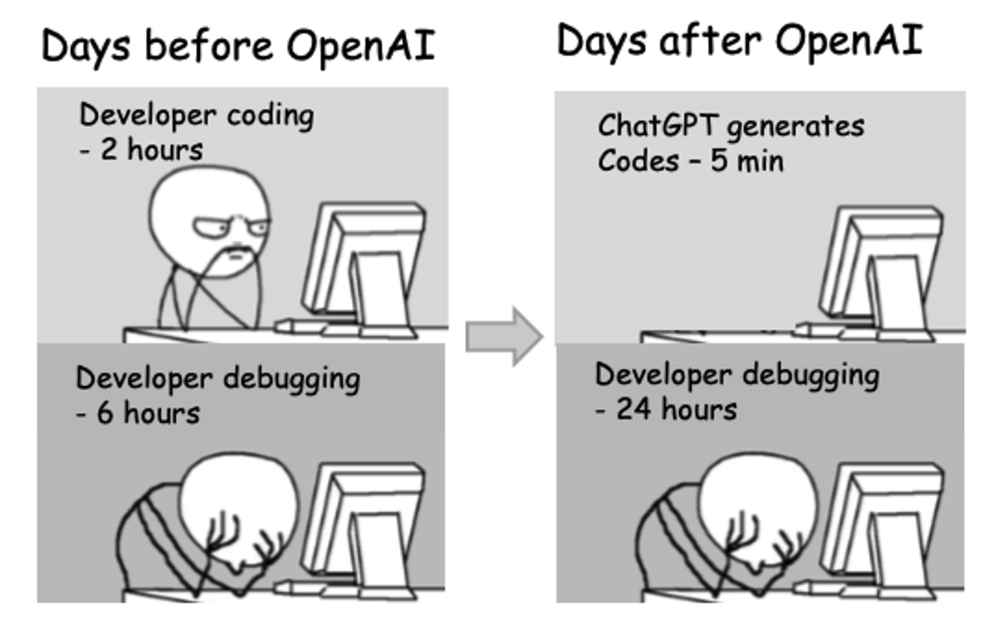

Slide 7
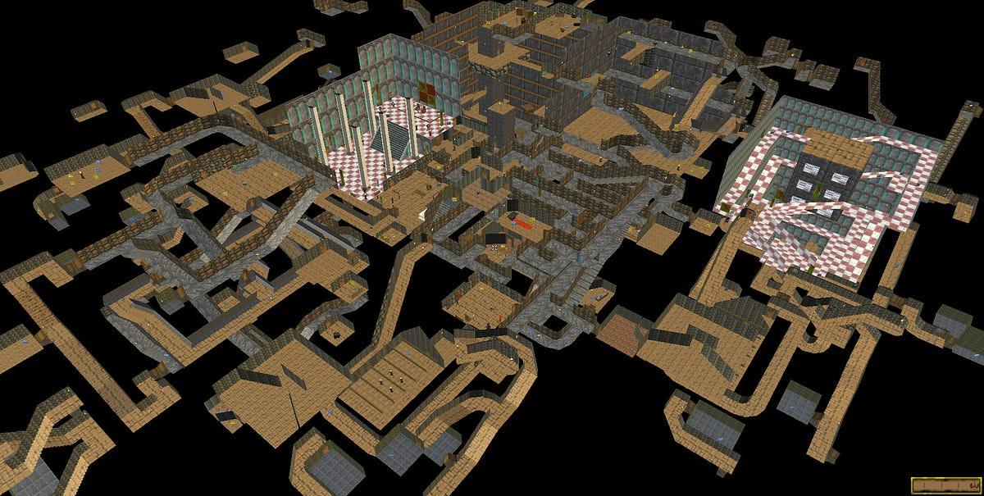
A Dungeon Map from TES II: Daggerfall

Slide 8
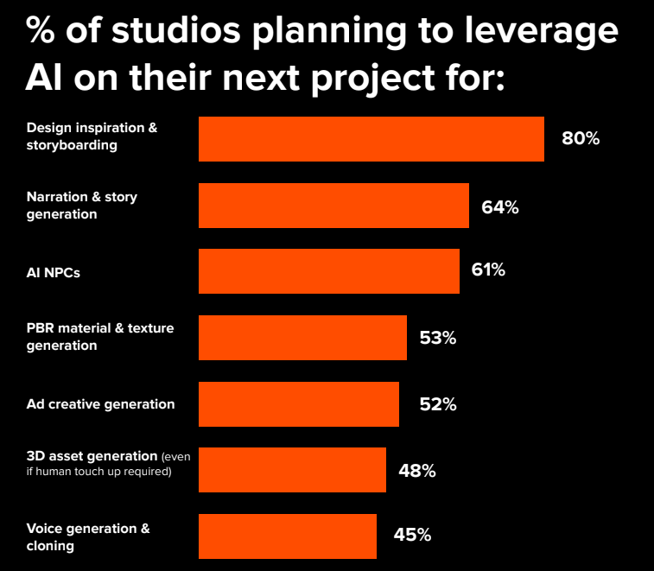
64% of Studios Plan to Fine-Tune & Train their own In-House Models

Slide 9
Thank you all for your time and attention today

